Slide 1


Single Statement Suites
Here is an example of a one-line if clause −
#!/usr/bin/python
a=10
if(a == 20):
print("a is equal to 20")

Slide 2
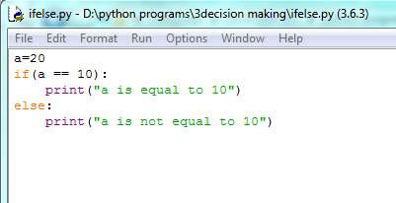
if-else statement
a=20
if(a == 10):
print("a is equal to 10")
else:
print("a is not equal to 10")

Slide 3
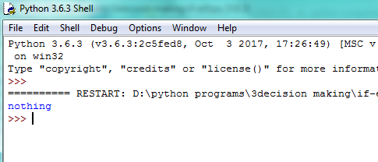
if elif statement
v = "z"
if v == "a":
print("Vowel a")
elif v == "e":
print("Vowel e")
elif v == "i":
print("Vowel i")
elif v == "o":
print("Vowel o")
elif v == "u":
print("Vowel u")
else:
print("nothing")

Slide 4
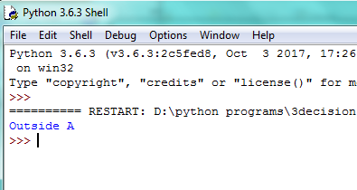
nested if statement
a=10
b=20
if(a == 30):
if(b == 20):
print("Inside B")
else:
print("Outside B")
else:
print("Outside A")

Slide 5
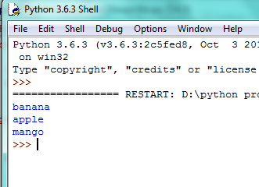
For loop
for iterating_var in sequence:
statements(s)
sequence means the array name and iterating var is the variable
fruits = ['banana', 'apple', 'mango']
for fruit in fruits:
print (fruit)

Slide 6
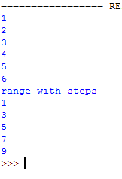
For loop with range
numbers = [1,2,3,4,5,6,7,8,9,10]
for i in range(1, 7):
print(i)
# print value 1 to 10 with step 2
for i in range(1, 10, 2):
print(i)

Slide 7
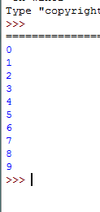
WHILE LOOP
The syntax of a while loop in Python programming language is −
while expression:
statement(s)
count = 0
while count < 10:
print(count)
count += 1 #count=count+1

Slide 8
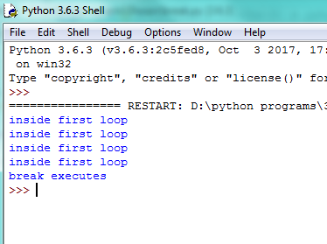
Break
i=0
for i in range(1,10):
if i == 5:
break
print("inside first loop")
print("break executes")

Slide 9
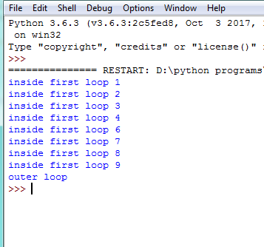
Continue
count = 0
i=0
for i in range(1,10):
if i == 5:
continue
print("inside first loop",i)
print("outer loop")

Slide 10
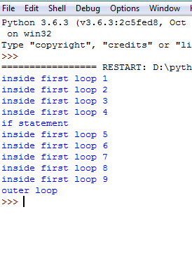
Pass
count = 0
i=0
for i in range(1,10):
if i == 5:
pass
print("if statement")
print("inside first loop",i)
print("outer loop")

